Slide 1
Adelaide Suburb Housing Prices: Pre and Post COVID-19 Analysis
By Group 3:
Jordan Kane
Van Hoang
Isha Sharma
Magdalene Singh

Slide 2


Group Question: “Has the price of housing in the Adelaide suburbs changed since before and after COVID?”

Slide 3
Group Data Source
Our data source was the Metro median house sales data from data.sa.gov.au.
Reliable government data source.
Contains the quarterly median house prices for metropolitan Adelaide by suburb from 2015-2023.
REFERENCE:
Department of Planning, T. and I. (2023). Metro median house sales. data.sa.gov.au. [online] Available at: https://data.sa.gov.au/data/dataset/metro-median-house-sales.

Slide 4
Group Roles
Each member focuses on a small selection of 2-5 suburbs from each direction of the city.
The combination of all directions from the CBD provides a full range of suburbs within Adelaide.
Different directions may provide different outcomes and results from one another.
Jordan: Eastern Suburbs (Norwood & Burnside)
Isha: Northern Suburbs (Modbury, Salisbury, North Adelaide & Enfield)
Magdalene: Western Suburbs (Greenacres, Grange & Seaton)
Van: Southern Suburbs (Flagstaff Hill, Goodwood, Edwardstown, Pasadena & Adelaide CBD)

Slide 5
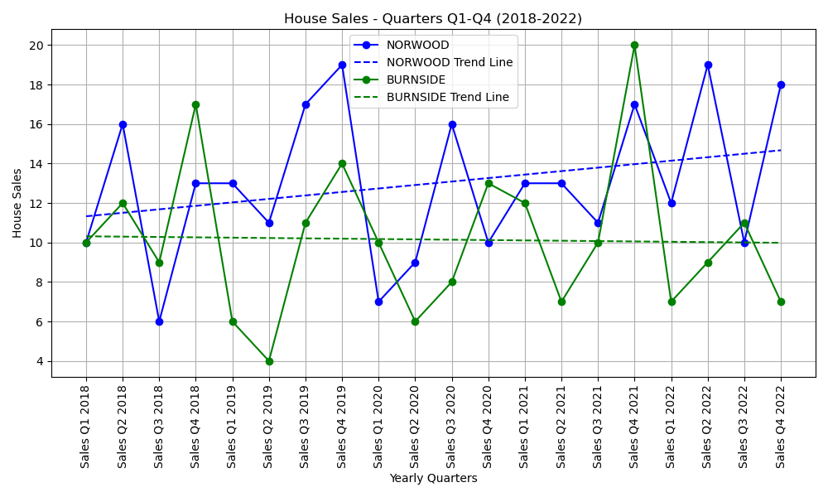
Eastern Suburbs: “Has the number of house sales in Norwood and Burnside changed from 2018-2022?”

Slide 6
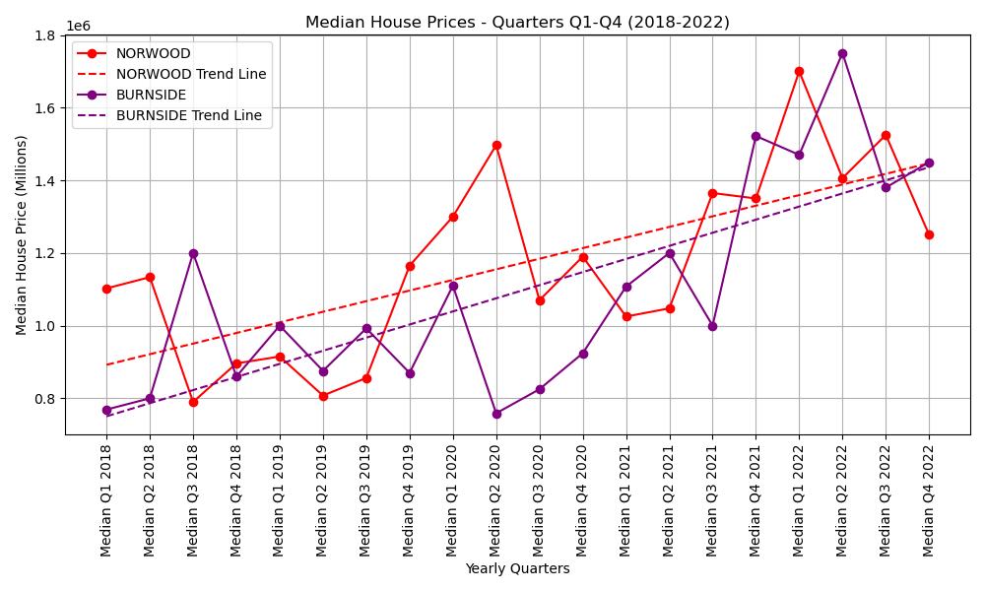
Eastern Suburbs: “Has the median house price in Norwood and Burnside changed from 2018-2022?”

Slide 7
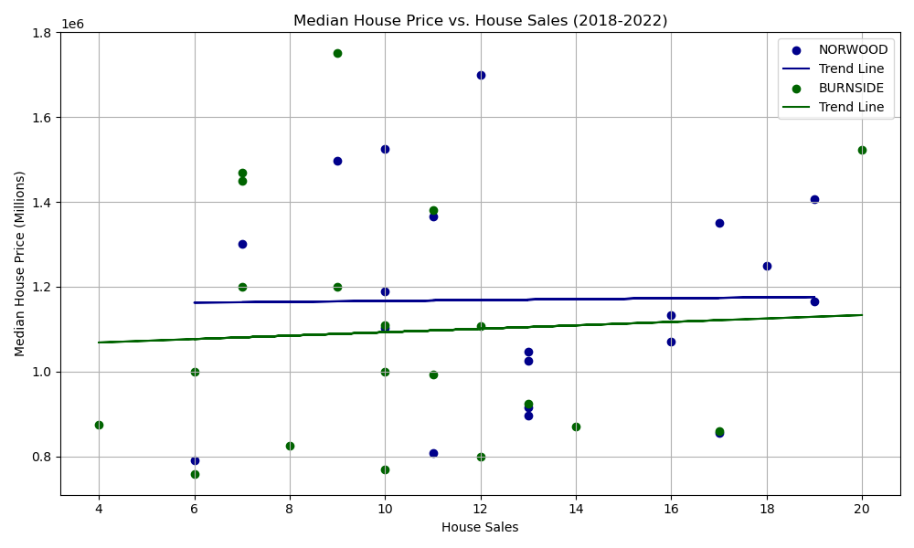
Eastern Suburbs: “Has the number of house sales impacted the median house price in Norwood and Burnside from 2018-2022?”

